Slide 1
Reverse Engineering the Stream Prefetcher for Profit
SILM@EURO S&P’2020
Aditya Rohan, Biswabandan Panda and Prakhar Agarwal
(Indian Institute of Technology Kanpur)

Slide 2
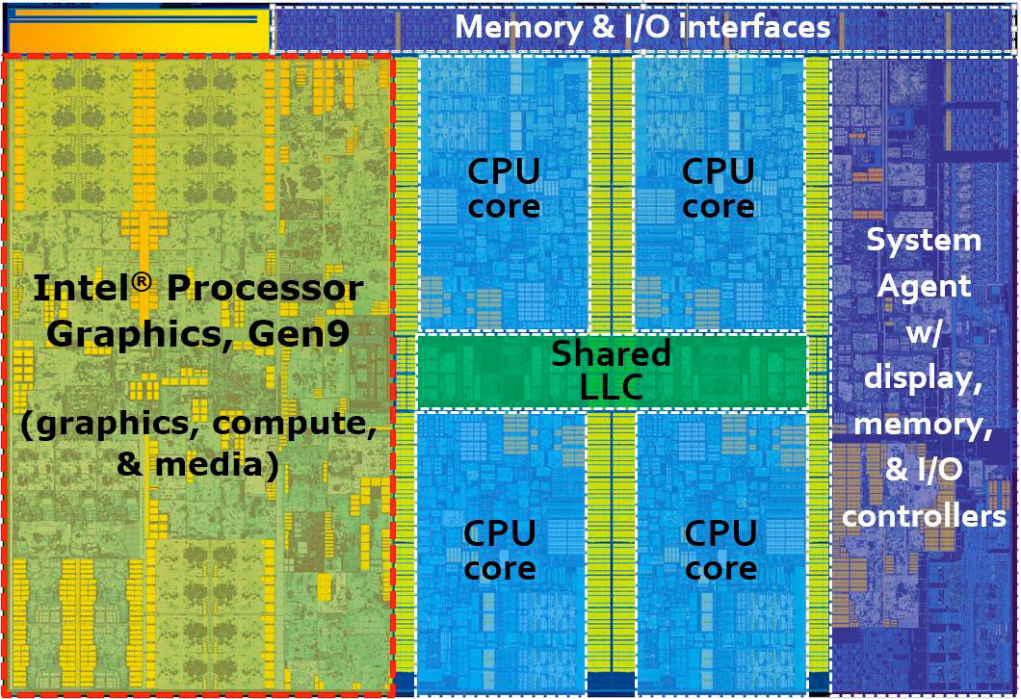
Rise of Micro-architectural Attacks

Slide 3
Rise of Micro-architectural Attacks
BTB
OoO
ROB
SE
Streamer
Stride Prefetcher
TLB

Slide 4
Rise of Micro-architectural Attacks
BTB
OoO
ROB
SE
Streamer
Stride Prefetcher
TLB

Slide 5
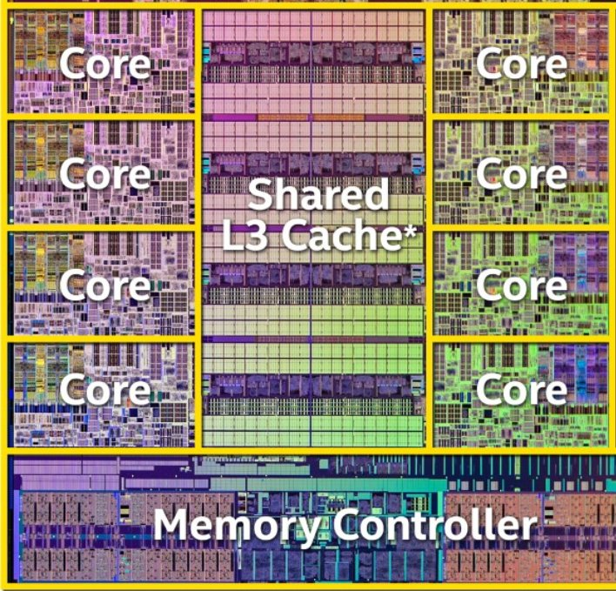
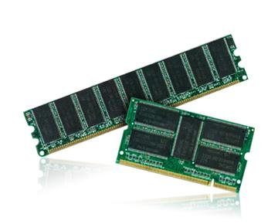
Covert Channel Attack
Sender
Receiver
Notes:
Here, L3 cache and DRAM are shared between attacker and victim. Which can be used as memory based side-channel to mount an attack.

Slide 6
Streamers as a Covert Channel?
Side-channel attack on the stride prefetcher [CCS’18]
Streamers are shared between hyperthreads
(as we will show)
A cross-thread covert-channel in an SMT core

Slide 7
The Stream Prefetcher
A latency hiding technique that speculates the future accesses
Maintains a record of access patterns
Great for programs that access contiguous addresses

Slide 8
The Stream Prefetcher
T0
T1
Core
L1$
L2$
Streamer

Slide 9
The Stream Prefetcher
1
2
3
4
5
6
7
8
9
10
11
12
13
T1
Thread1 accesses line1

Slide 10
The Stream Prefetcher
T1
1
2
3
4
5
6
7
8
9
10
11
12
13
T1
Thread1 accesses line2

Slide 11
The Stream Prefetcher
T1
1
2
3
4
5
6
7
8
9
10
11
12
13
T1
T1
Thread1 accesses line3

Slide 12
The Stream Prefetcher
T1
1
2
3
4
5
6
7
8
9
10
11
12
13
T1
T1
A stream table entry is created

Slide 13
The Stream Prefetcher
T1
T2
1
2
3
4
5
6
7
8
9
10
11
12
13
T1
T1
Trigger : Thread2 accesses line4

Slide 14
The Stream Prefetcher
T1
T2
1
2
3
4
5
6
7
8
9
10
11
12
13
Prefetched Lines
T1
T1
Streamer prefetches lines

Slide 15
The Stream Prefetcher
Distance
T1
T2
1
2
3
4
5
6
7
8
9
10
11
12
13
Prefetched Lines
T1
T1
How far ahead is the first prefetched line?

Slide 16
The Stream Prefetcher
Degree
T1
T2
1
2
3
4
5
6
7
8
9
10
11
12
13
Prefetched Lines
T1
T1
How aggressively do we prefetch?

Slide 17
Other Prefetchers in Intel
L2 Stream
L2 Adjacent Line
1
1
1
0
L1 Next-Line
MSR: 0x1a4
L1 IP-based Stride

Slide 18
Our Goal: What are we trying to answer?
What is the size of the Stream Table?
Is the Stream Prefetcher shared b/w SMT threads?
What triggers the stream prefetcher with cross-thread accesses?
At which misses made by cross-threads does the streamer prefetch?
Can the Streamer leak?

Slide 19
Our Setup and Assumptions
Two SMT threads on an isolated core
All prefetchers except the streamer disabled
Intel Kaby Lake i5, 4 cores(SMT), 64KB L1, 256KB L2

Slide 20
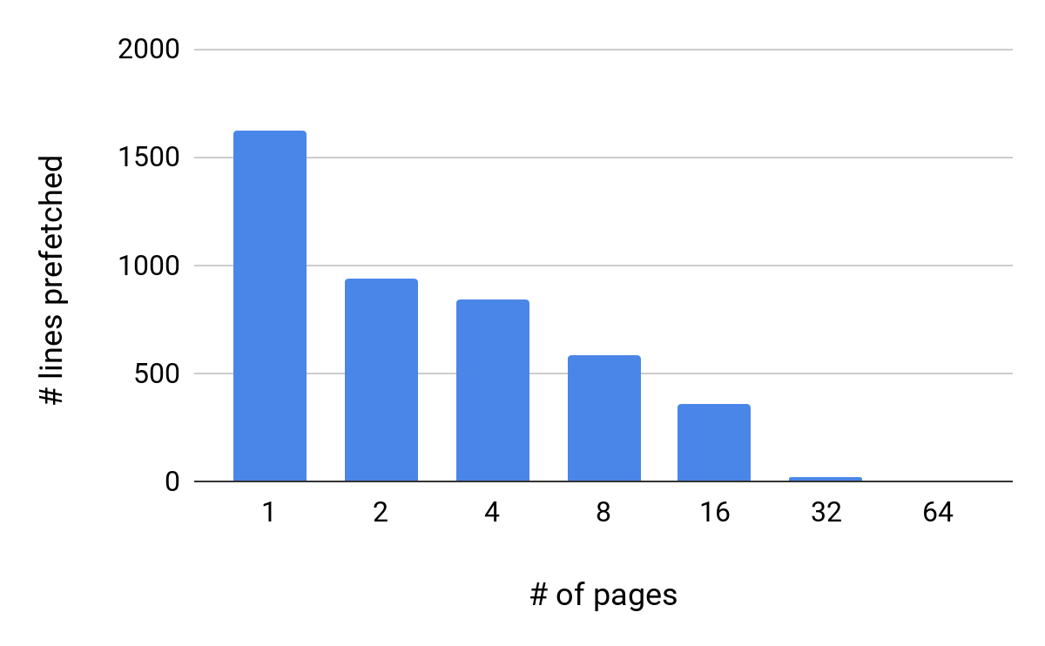
Experiment 1: How big is the stream table?
Insight: Stream table can store 16 entries

Slide 21
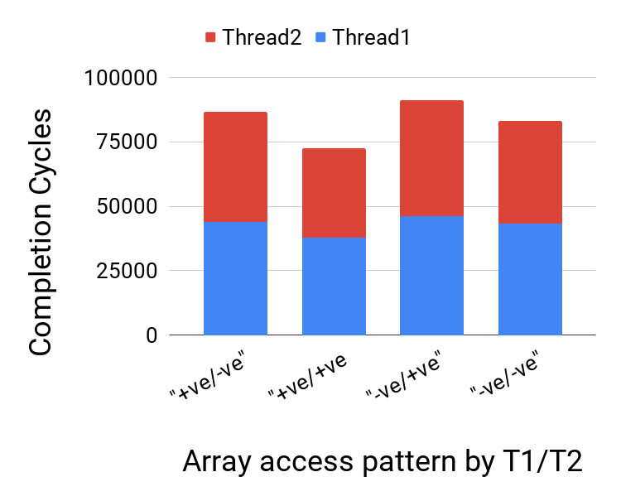
Experiment 2: Is the streamer shared?
Insight: Shared b/w SMT threads on the same core

Slide 22
Experiment 3: What triggers the stream prefetcher with cross-thread accesses?
1
2
3
4
5
6
7
8
9
10
11
T1
Thread1 accesses line1

Slide 23
Experiment 3: What triggers the stream prefetcher with cross-thread accesses?
T2
1
2
3
4
5
6
7
8
9
10
11
T1
Trigger : Thread2 accesses line2

Slide 24
Experiment 3: What triggers the stream prefetcher with cross-thread accesses?
T2
1
2
3
4
5
6
7
8
9
10
11
Prefetched Lines
T1
Insight: Two misses can trigger the streamer

Slide 25
Experiment 4: At which misses made by cross-threads does the streamer prefetch?
1
2
3
4
5
6
7
8
19
20
21
22
23
T1
Thread1 accesses line1

Slide 26
Experiment 4: At which misses made by cross-threads does the streamer prefetch?
1
2
3
4
5
6
7
8
19
20
21
22
23
T1
T2
Trigger : Thread2 accesses line20

Slide 27
Experiment 4: At which misses made by cross-threads does the streamer prefetch?
Prefetched Lines
1
2
3
4
5
6
7
8
19
20
21
22
23
T1
T2
Nothing out of the ordinary!!

Slide 28
Experiment 4: At which misses made by cross-threads does the streamer prefetch?
Prefetched Lines
Prefetched Lines
1
2
3
4
5
6
7
8
19
20
21
22
23
T1
T2
Nothing out of the ordinary!! Right?

Slide 29
Experiment 4: At which misses made by cross-threads does the streamer prefetch?
Prefetched Lines
Prefetched Lines
1
2
3
4
5
6
7
8
19
20
21
22
23
T1
T2
Insight: Prefetching happens at the trigger and the previous miss

Slide 30
Our Goal: What are we trying to answer?
What is the size of the Stream Prefetcher?
L2 Stream prefetcher has 16 entries
Shared b/w SMT threads on the same core
Is the Stream Prefetcher shared b/w SMT threads?
Two misses can trigger the streamer
What triggers the stream prefetcher with cross-thread accesses?
At which misses made by cross-threads does the streamer prefetch?
Prefetching happens at trigger and the previous miss
Can the Streamer leak?

Slide 31
What are we trying to answer?
Shared b/w SMT threads on the same core
Is the Stream Prefetcher shared b/w SMT threads?
What triggers the stream prefetcher?
Two misses can trigger the streamer
Prefetching happens at trigger and the previous miss
At which misses does the streamer prefetch?
Can the Streamer leak?

Slide 32
Flush based Cache Attacks: (Flush+Reload)
SENDER
RECEIVER
Step 0: Sender and receiver agree on a few cache sets
L2
Notes:
On basis of hit/miss, attacker confirms whether victim has accessed the set or not.

Slide 33
Flush based Cache Attacks: (Flush+Reload)
SENDER
RECEIVER
Step 0: Sender and receiver agree on a few cache sets
Step 1: Sender flushes cache sets while running
L2
Notes:
On basis of hit/miss, attacker confirms whether victim has accessed the set or not.

Slide 34
Flush based Cache Attacks: (Flush+Reload)
SENDER
RECEIVER
Step 0: Sender and receiver agree on a few cache sets
Step 1: Sender flushes cache sets while running
Step 2: Receiver reloads the cache set
L2
Notes:
On basis of hit/miss, attacker confirms whether victim has accessed the set or not.

Slide 35
Flush based Cache Attacks: (Flush+Reload)
SENDER
RECEIVER
Step 0: Sender and receiver agree on a few cache sets
Step 1: Sender flushes cache sets while running
Voila
Step 2: Receiver reloads the cache set
L2
Low latency: 1, High latency: 0
Notes:
On basis of hit/miss, attacker confirms whether victim has accessed the set or not.

Slide 36
Streamer as Covert Channel
SENDER
RECEIVER
1
2
3
L2
Notes:
On basis of hit/miss, attacker confirms whether victim has accessed the set or not.

Slide 37
Streamer as Covert Channel
SENDER
RECEIVER
Step 0: Sender flushes all cache lines in a page
1
2
3
L2
Notes:
On basis of hit/miss, attacker confirms whether victim has accessed the set or not.

Slide 38
Streamer as Covert Channel
SENDER
RECEIVER
Step 0: Sender flushes all cache lines in a page
Step 1: Sender accesses line1, line2, line3 lines of the page
1
2
3
L2
Notes:
On basis of hit/miss, attacker confirms whether victim has accessed the set or not.

Slide 39
Streamer as Covert Channel
SENDER
RECEIVER
Step 0: Sender flushes all cache lines in a page
Step 1: Sender accesses line1, line2, line3 lines of the page
Voila
Step 2: Receiver accesses line4 of the same page
1
2
3
L2
Notes:
On basis of hit/miss, attacker confirms whether victim has accessed the set or not.

Slide 40
Streamer as Covert Channel
SENDER
RECEIVER
Step 0: Sender flushes all cache lines in a page
Step 1: Sender accesses line1, line2, line3 lines of the page
Voila
Step 2: Receiver reloads line4 of the same page
1
2
3
L2
Low latency: 1, High latency: 0
Notes:
On basis of hit/miss, attacker confirms whether victim has accessed the set or not.

Slide 41
Streamer as Covert Channel
SENDER
RECEIVER
Low latency: 1, High latency: 0
Bandwidth 54.44 KB/s
Voila
1
2
3
L2
Accuracy 91.3%
Notes:
On basis of hit/miss, attacker confirms whether victim has accessed the set or not.

Slide 42
Our Goal: What are we trying to answer?
What is the size of the Stream Prefetcher?
L2 Stream prefetcher has 16 entries
Shared b/w SMT threads on the same core
Is the Stream Prefetcher shared b/w SMT threads?
What triggers the stream prefetcher with cross-thread accesses?
Two misses can trigger the streamer
At which misses made by cross-threads does the streamer prefetch?
Prefetching happens at trigger and the previous miss
Yes! as a covert channel and possibly as a side channel
Can the Streamer leak?

Slide 43
Our Goal: What are we trying to answer?
What is the size of the Stream Prefetcher?
L2 Stream prefetcher has 16 entries
Shared b/w SMT threads on the same core
Is the Stream Prefetcher shared b/w SMT threads?
What triggers the stream prefetcher with cross-thread accesses?
Two misses can trigger the streamer
At which misses made by cross-threads does the streamer prefetch?
Prefetching happens at trigger and the previous miss
Yes! as a covert channel and possibly as a side channel
Can the Streamer leak?

Slide 44
Thank You!

Slide 45
What are we trying to answer?
Shared b/w SMT threads on the same core
Is the Stream Prefetcher shared b/w SMT threads?
What triggers the stream prefetcher?
Two misses can trigger the streamer
Prefetching happens at trigger and the previous miss
At which misses does the streamer prefetch?
Can the Streamer leak?
Yes! as a covert channel and possibly as a side channel

Slide 46
What is Reverse Engineering? Why?
To attack we need to understand how Streamer works
Intel prefetchers are undocumented
Side-channel attack on the Stride prefetcher [CCS’18]
A cross-thread covert-channel in an SMT core

Slide 47
What is a Hardware Prefetcher?
A latency hiding technique that speculates the future accesses
Prefetches cache lines before the processor demands
Some popular ones: next-line, stride, and stream prefetchers

Slide 48
Challenges in Reverse Engineering
Noise from other prefetchers
Noise from other applications
Inconsistent RDTSC readings

